Slide 1

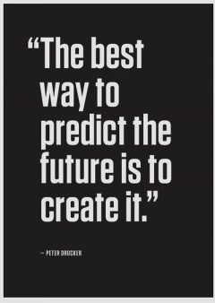

AUGUR
- A CANDIDATE ACCEPTANCE PREDICTING MODEL
ARCHIT SRIVASTAVA - 12120052
DIPTI ASHOK BELURGIKAR - 12120099
JATIN SAHNAN - 12120098
KARTIKEY AJAY RAI - 12120014
SWATI YADAV - 12120084

Slide 2






Business Objective
Data Collection
Success Criteria
Feasibility
Data Quality Verification
Minimizing cost
Secondary source: External
Limited data scraping
NLP based data
converted to structured
Format.
Skillset list design using
Project.
Business: To reduce the time of
Most job portals doesn't
Data received from HR
Primary source: Job portal
data from HR consultancy.
from Indeed.
allow data scraping.
consultancy firms are
confidential.
of recruitment process.
Business Constraints
for each candidate.
Attributes influencing
acceptance are different
ML: Accuracy of our model
Economic: Costs of recruitment
should be more than 80%.
recruitment by half.
to be reduced by approx.
40%.
NER for validation of
Business & Data Understanding
Business Problem:
Recruiters undergo complex procedures to hire candidates.

Slide 3
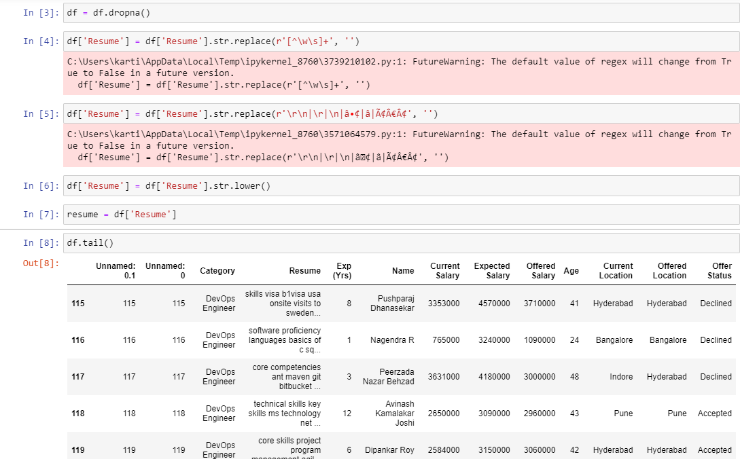
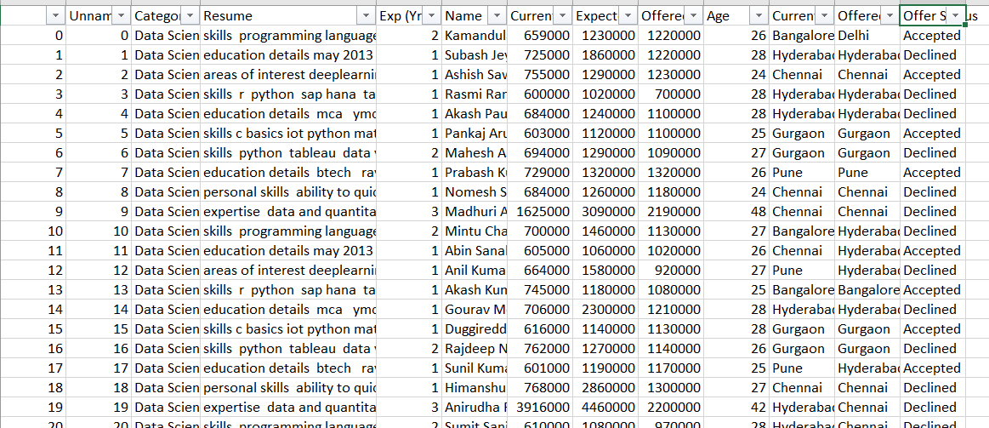
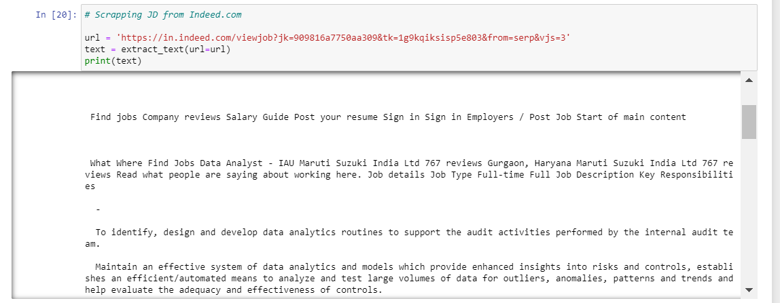
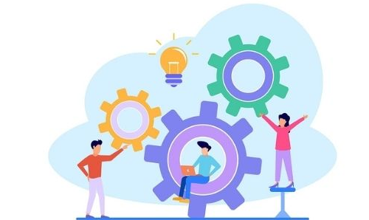
Web Scraping and Data Cleaning
We scraped job descriptions of data analyst roles from Indeed.com
Received dataset from HR firm
Cleaned the dataset for any blank spaces, stop words, etc. using NLP

Slide 4
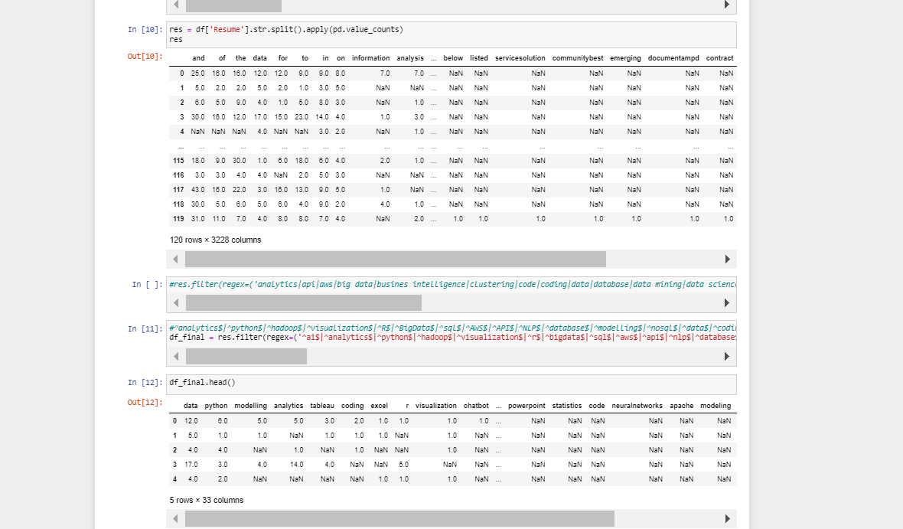
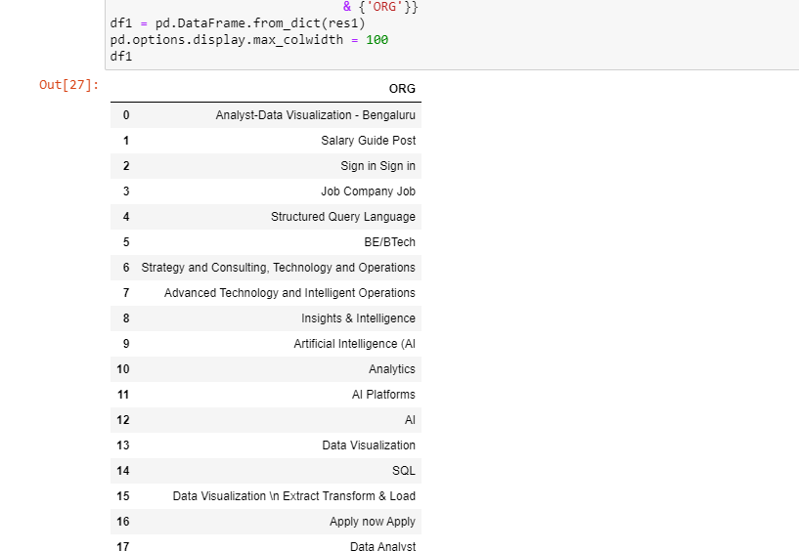
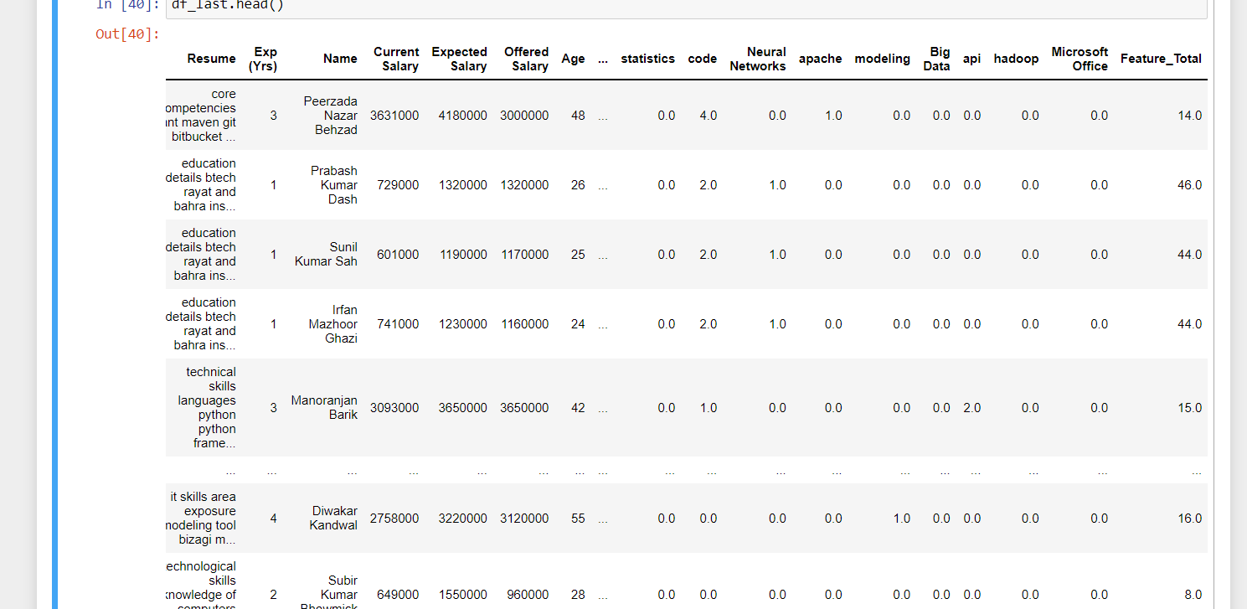

Feature Selection and Feature Extraction
We used NER to get the specific skills of the data analysts from the scraped content as per the job description
We selected only non-categorical data for our prediction model –
such as Years of Experience, Current Salary, Expected Salary, etc.
We created a bag of words by observing a bunch of resumes and collected keywords such as
‘Analytics’, ‘Power BI’, ‘Python’, ‘Visualization’, etc.
We constructed new column called Feature Total for the Total score of each candidate with
respect to the frequency of the skills that appear in his/her resume.

Slide 5


ATS MODEL & PREDICTING MODEL
AUGUR
Scraping of skillset from website and using NER
DATASET OF RESUME
Feature Extraction
Skillset of each
individual
Logistic Regression to predict will candidate accept the offer or not
DATA
CLEANING
Defined the list of Skill Set for Data Analyst/Scientist/Engineer/Science
Total Score as per the skill set found in the resume
Skills Score
DATASET RECEIVED FROM HR
Experience, Expected Salary, Present Salary, Offered Salary, Location Criteria

Slide 6
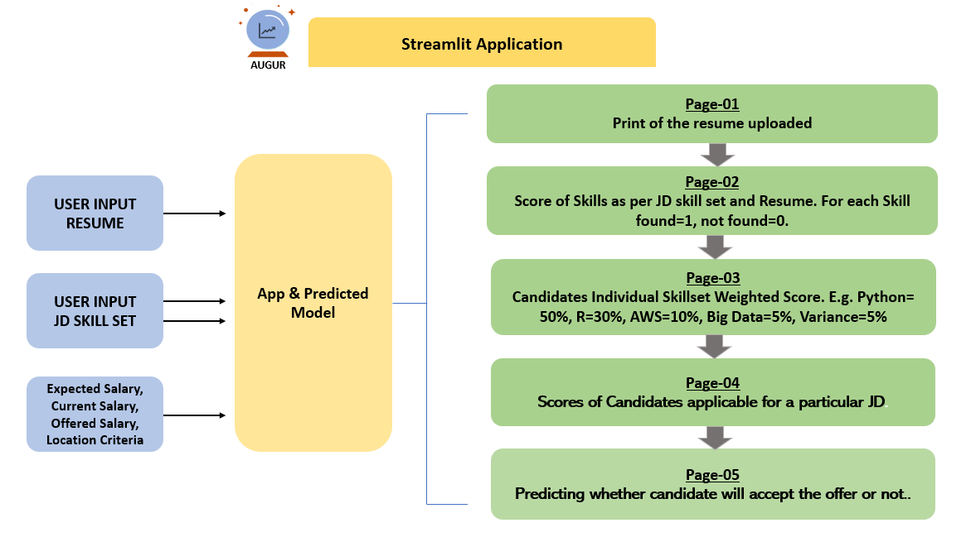
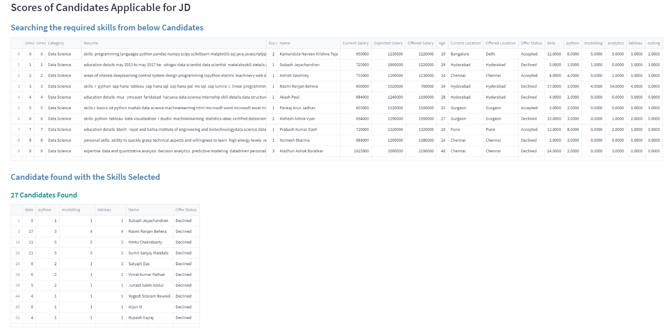
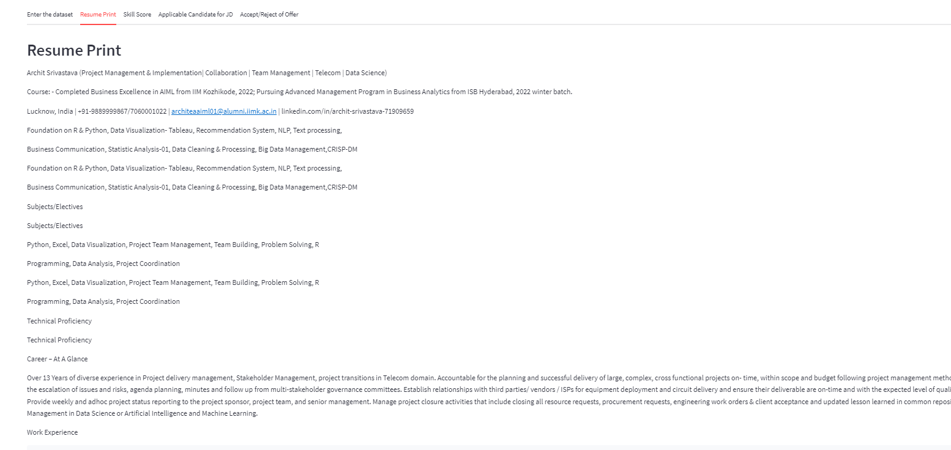
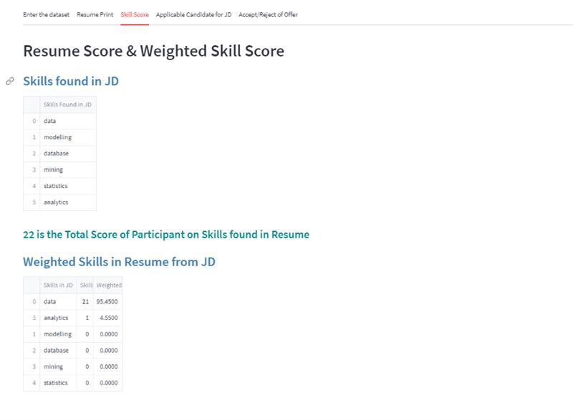
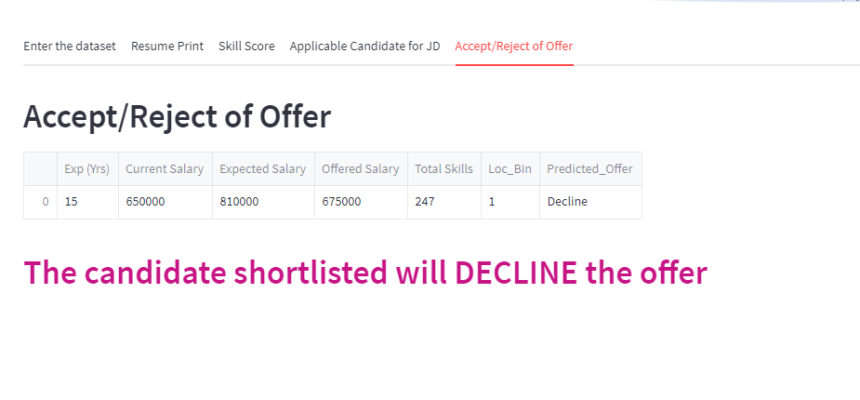
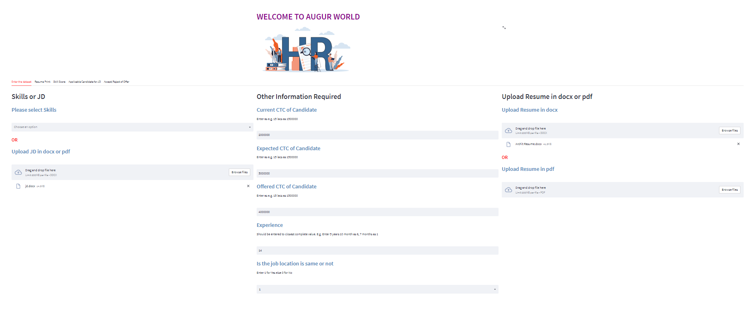
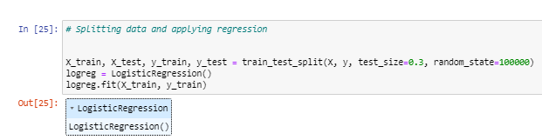

PAGE 5: CANDIDATE ACCEPTS/REJECTS THE OFFER
PAGE 2, 3: SCORES
PAGE 4: SCORES OF APPLICABLE CANDIDATES
HOME PAGE, RESUME PRINT

Slide 7
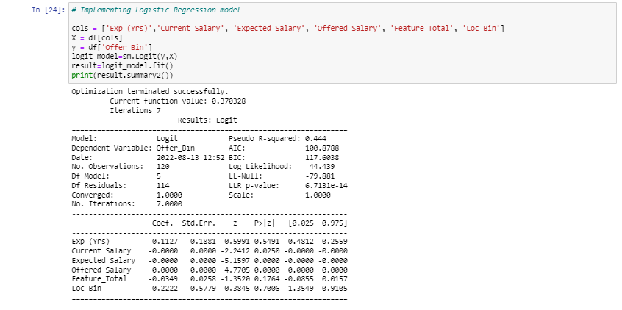
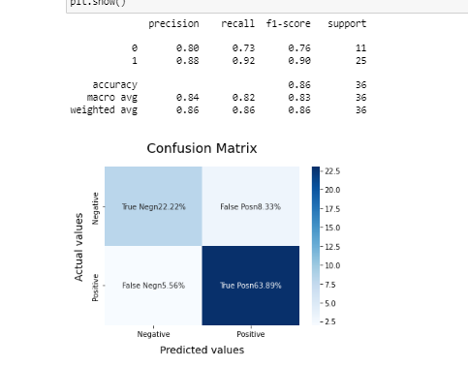
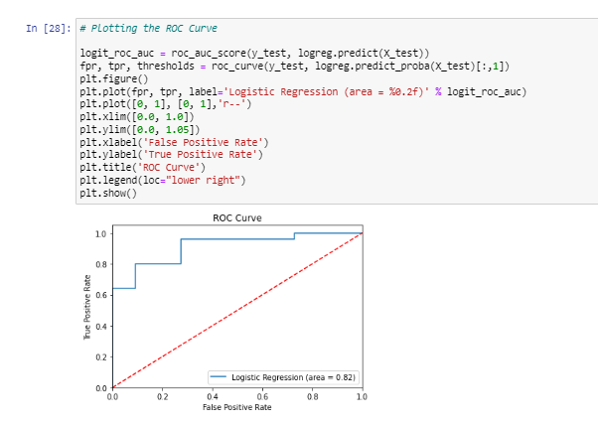

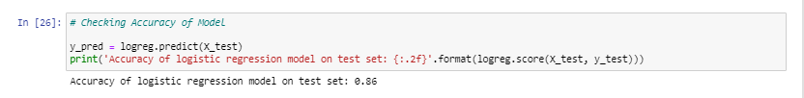
ACCURACY OF OUR MODEL

Slide 8
PERFORMANCE VALIDATION
DETERMINE ROBUSTNESS
INCREASE EXPLAINABILITY
COMPARE RESULTS WITH DEFINED SUCCESS CRITERIA
We initially started with a run-
We analyzed all the features
The Candidate selection
time was reduced by half and
We verbally verified few
Cost of recruitment process is
achieved model accuracy approx.
80%.
time of 10-12 seconds. The
runtime is now reduced by 50%.
values from anonymous HRs,
and found our prediction to
work accurately for 75% of
the data.
reduced by approx. 40%
selected in our dataset and
found that the age
parameter was irrelevant in
prediction, thus, we decided
not to consider it in our
model.
Evaluation
INFERENCE
HARDWARE
MODEL EVALUATION CONDITION FOR PRODUCTION
ASSURE USER ACCEPTANCE
DEPLOYMENT STRATEGY
Local Host Server with
Model is able to
Update of python libraries as per upgrade notifications, timely check for modifications on the Streamlit app as per feature enabling or disabling done by Software
The launch would consist of
MINIMIZE RISKS
predict ideal candidates
in real time data.
Processor I5 Gen 11 &
min. 8Gb RAM
above
Phase 1: Rolling out of entire
Phase 2: Updating skillset
Dictionary and rolling out
Phase 3: In future, we can
three phases:
Version2 - approx. 9-24 months
Model – approx. 3 months
perform migration of model to
Cloud – after 1-2 years
Deployment
We are trying to procure
datasets from other
Industries to evaluate the
User acceptance based
on the success criteria
Notes:
COMPARE RESULTS WITH DEFINED SUCCESS CRITERIA
To be checked with real data set

Slide 9







Non-stationery data distribution
Degradation of Hardware
System Updates
Monitor
Update
Model will automatically
Ensuring a safe backup in
Continuous retesting of
Updating skill set
With any changes or
input data, algorithms,
and environment to
Updating software
align itself with the
different Job Descriptions,
help of Streamlit
Application.
case of any hardware
degradation. Being active
in troubleshooting for any
hardware issues.
upgradation in the
Libraries/Python
Versions/Streamlit we will
update the code in
maintenance window.
identify any warning
messages and necessary
action to be taken.
Dictionary every quarter
versions to ensure smooth
functioning of the model.
made possible with
as per different JD’s
encountered.
Monitoring and
Maintenance

Slide 10
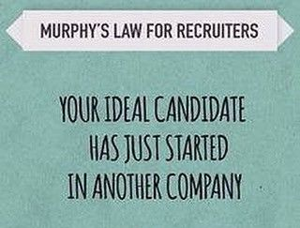
AUGUR
THANK YOU!

